Slide 1
BEEF + LAMB NEW ZEALAND
GENERATION NEXT PROGRAMME
INTRODUCTION

Slide 2
HOW DOES THE PROGRAMME WORK?
Module 1 Understanding the farming business as a whole
Webinar Farm pathways
Module 2 Technology , Genetics & Building Better Teams
Module 3 Meat Appreciation

Slide 3
Our strategy | Beef + Lamb New Zealand

Slide 4
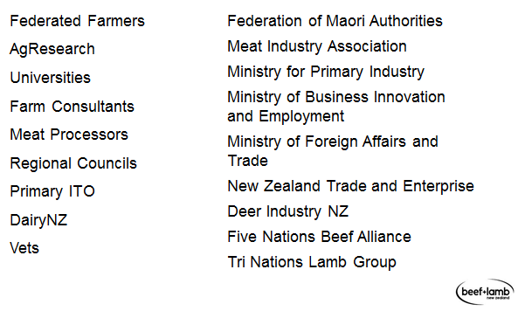
SOME EXAMPLES OF WHO B+LNZ WORKS WITH

Slide 5
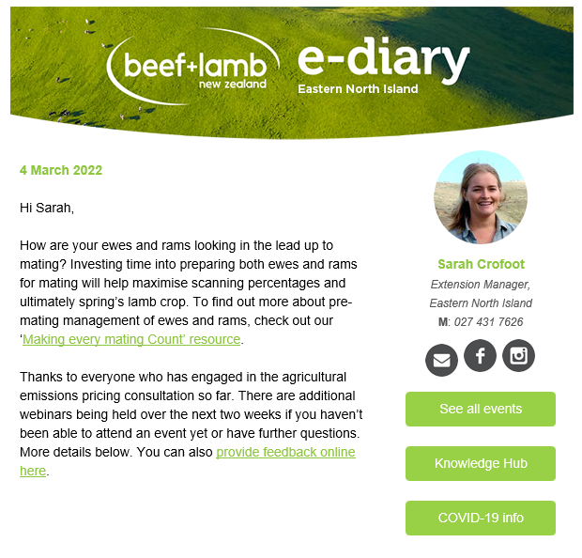
WEEKLY E-DIARY
Friday morning highlights:
Upcoming events
Industry news
Regional notices
Topical resources
You should all be signed up but can stop them anytime

Slide 6
Sign up to be at the front of the queue when we release our key economic reports and agricultural forecasts.
Beef + Lamb New Zealand's Economic Service publishes five bulletins annually, linked to the:
Lamb Crop
New Season Update
Mid-Season Update
Stock Number Survey
Cost Movement Report

Slide 7
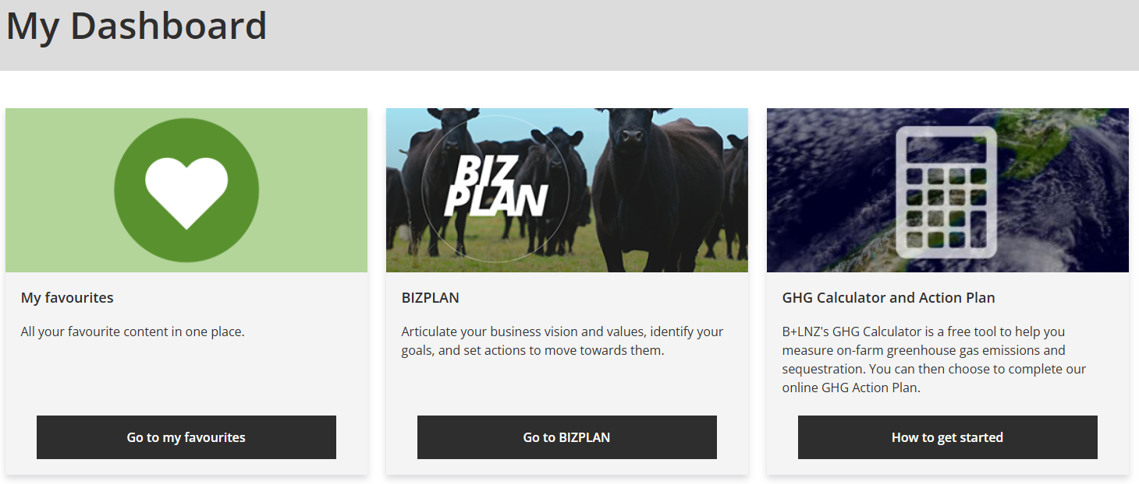
Notes:
Set up your own log in and dashboard
Search for and save resources
Alumni page coming soon

Slide 8
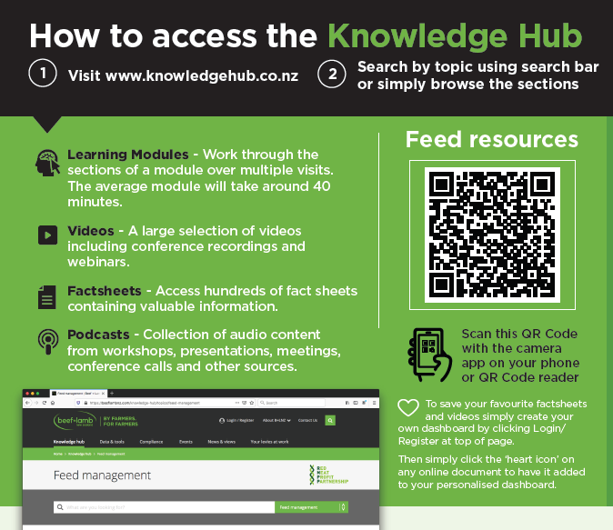
THE KNOWLEDGE HUB
www.knowledgehub.co.nz

Slide 9
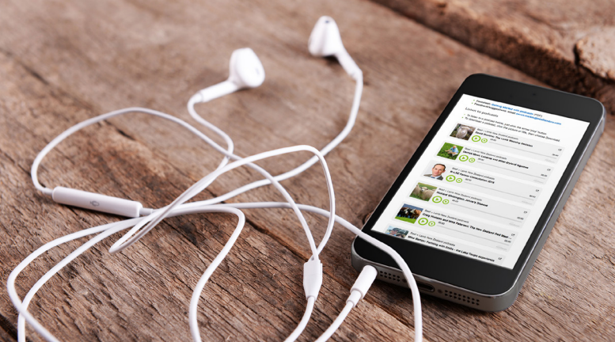
PODCASTS
Listen on the go & learn while your busy
FIND B+LNZ PODCASTS
on your phone
Open your podcast app and search for Beef + Lamb New Zealand or “Scene + Herd”
On your computer
Visit our knowledge hub, then click the drop down box to select a relevant topic. Our podcasts will appear near the top and are labelled with the keyword “PODCAST”.

Slide 10
Alerts to your phone
Regional Focus
Pest Alerts:
Get region-specific texts straight to your mobile phone.
We'll alert you to weeds and pests that affect pastures and feed crops, and give you tips for managing them.
Register now for...
free local alerts suitable for all farm types
when to monitor
how to treat or prevent
access to more detailed information and support
Lucerne Texts:
Get lucerne management texts straight to your mobile phone.
Register now for...
free region-specific information and support
real-time updates to help you get the best out of drought-tolerant lucerne
a direct line to forage information from Professor Derrick Moot, a specialist in lucerne management at Lincoln University

Slide 11
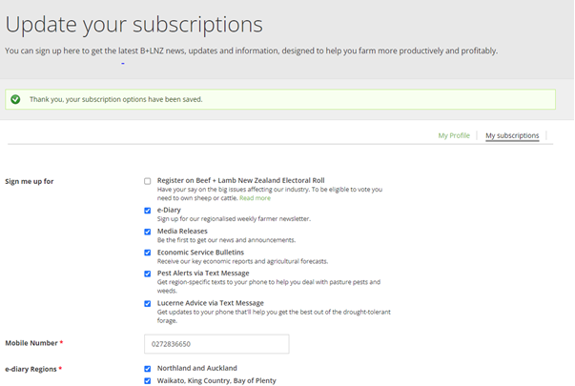
Keep your subscription
preferences up to date
> B+LNZ Dashboard
> Account Settings
> Update your subscriptions

Slide 12
WHAT MAKES A GOOD MENTOR?
They practice what they preach​
They won’t be prefect but will be able to help you learn what you want to learn. Look for someone who ‘walks the walk’ on the thing you want to one day be part of​
They want to invest in you, and you want to invest in them​
Mentorship goes both ways. Valuable mentorship happens when both parties are feeding each other knowledge in some way shape or form​
They know when to push you​
A good mentor knows how far to push you, and you are going to question it. They should make you feel comfortably uncomfortable = Growing pains ​
They care about you as a human being​
A mentorship is about so much more than just "learning" something. A mentorship challenges you as a person, as an emotional being, and that's where the real growth happens​
They want to see you succeed ​
A true mentor wants you to know everything they know. They want to teach you so that you can one day take what you've learned and integrate it with your own unique skill sets. Your mentor should be your biggest advocate, the one who you can always go back to and share in those early days of learning. They provide context, and are a reminder of where you first began--and they are proud to have seen you come so far.

Slide 13
Write down 1 or 2 names of who you are going to approach to be your mentor

Slide 15
As Individuals draw a picture that represents their life in 10 years time.
What would it look like? (10min)

Slide 16
Pair up and share that picture.
Your partner needs to note down the key things said about the picture. (5 min each)

Slide 17
Individually using the buddies view of the picture write goals to how you will achieve those outcomes and link / alter goals sheet brought with you
(10 mins)

Slide 18
ACTIONS FROM TODAY
Identify and find a mentor
Looking back on your goals and from what you have learnt today will you make any changes?
Visit www.knowledgehub.co.nz
Create your own login and dashboard
Start your own BizPlan
Have a play with your own figures for production and financial KPI’s
Join the WhatsApp group – invites have been sent
Complete a stock rec for your farm
Complete a personal budget
We will report back on the experience and any triggers it brings up at M2

