Slide 1
Beef + Lamb New Zealand Generation Next Programme
Nurturing Your Well-Being

Slide 2
WHO IS FARMSTRONG?
Farmstrong is a nationwide wellbeing programme for the rural community. Our aim is to help you live well to farm well.
Farmstrong is an initiative to help farmers, growers and their families to cope with the ups and downs of farming by sharing things they can do to look after themselves and the people in their business.

Slide 3
WHO IS RURAL SUPPORT ?
The Rural Support Trust is a nationwide charitable organisation set up to work with the rural community when times are tough on the farm or in the family.
We are rural people with a wide range of experience and knowledge in dealing with challenging situations.
Our services are free and confidential
Have facilitators who will travel to where they are needed.
Contact is one on one at a place that suits you.

Slide 4
WHAT ARE THE FIVE WAYS TO WELLBEING?
Notes:
Discussion in pairs then go around tables getting one from each table
Research shows there are five simple things you can do as part of your daily life – at work and at home – to build resilience, boost your wellbeing and lower your risk of developing mental health problems. These simple actions are known internationally as the Five Ways to Wellbeing

Slide 5
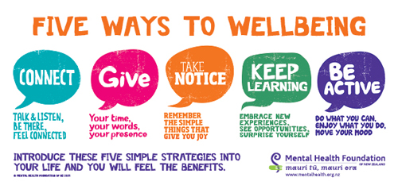
Notes:
Facilitate questions with the group to how they can action and display each way
Connect: Strengthening relationships with others and feeling close to and valued by others, including at work, is critical to boosting wellbeing.
e.g. With the people around you. With family, friends, colleagues and neighbours
Give: Carrying out acts of kindness, whether small or large, can increase happiness, life satisfaction and general sense of wellbeing.
Do something nice for a friend, or a stranger. Thank someone. Smile. Give your time. Check in on a mate. Join a community group
Take Notice: Paying more attention to the present moment, to thoughts and feelings and to the world around, boosts our wellbeing.
e.g. Be aware of the world around you and what you are feeling. Reflecting on your experiences will help you appreciate what matters to you.
Keep Learning: Being curious and seeking out new experiences at work and in life more generally positively stimulates the brain
e.g. Try something new. Rediscover an old interest. Sign up for that course. Fix a bike. Learn to play an instrument
Be Active: Being physically active, including at work, improves physical health and can improve mood and wellbeing and decrease stress, depression and anxiety.
e.g. Go for a walk or run. Step outside. Cycle. Play a game. Garden

Slide 6
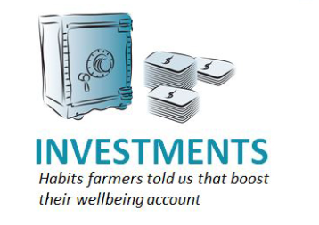
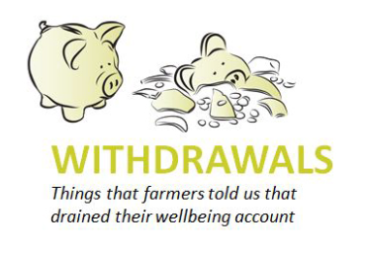
WHAT IS A WELL-BEING BANK ACCOUNT?
Having regular breaks and down time
Prioritising work tasks
Staying connected with positive people
Being well organised.
Eating well and staying fit
Being realistic about what you can complete each day
Having too much to do, all of the time
Lack of sleep
Relentless compliance obligations
Not getting time off the farm
Staffing problems
Succession worries
Financial uncertainty.

Slide 7
CREATE YOUR OWN WELL-BEING BANK ACCOUNT
What are your investments?
What are your withdrawals?
How can you reduce your withdrawals
/ increase your investments ?
Notes:
Handout to use: get them to have a go.
Page 2: https://staging.farmstrong.co.nz/wp-content/uploads/2020/02/Wellbeing-bank-account-handout.pdf

Slide 8
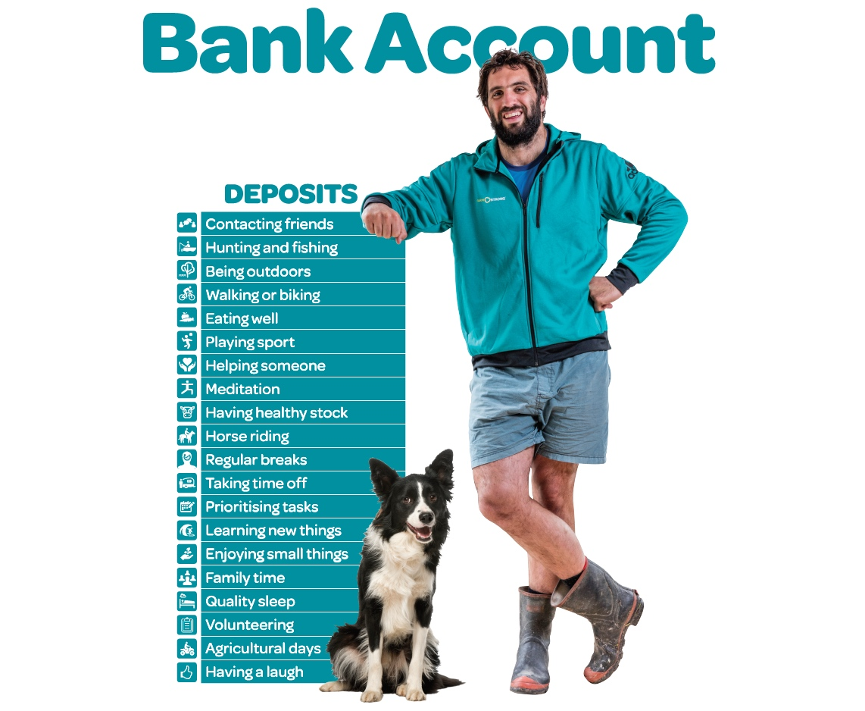
Notes:
Examples of deposits

Slide 9
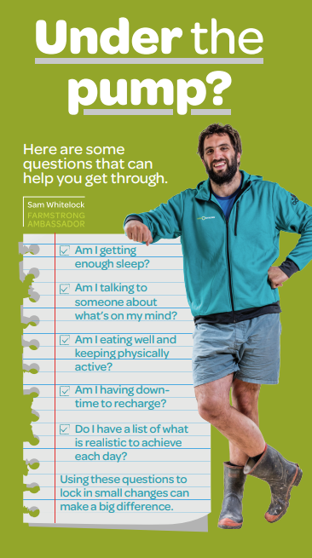
FOLLOWING TODAY
Refer to the
Under the Pump flyer
And go through the questions.
Notes:
Flyer to be handed out … Under the pump https://staging.farmstrong.co.nz/wp-content/uploads/2022/07/FS_DL_UnderPump-HueUpdate-final.pdf

Slide 10
HOW WE THINK
Behaviours
Life Events
Mindset
Thoughts
Emotions
Notes:
Thoughts, behaviours and emotions work together and reinforce each other
We often mistake our thoughts as absolute reality whereas there usually many different interpretations we can take
Realistically optimistic thoughts are the best as they lead to better outcomes
Changing behaviours to be more positive make us feel good and make out thoughts more positive, leading to more positive behaviour and so on

Slide 11
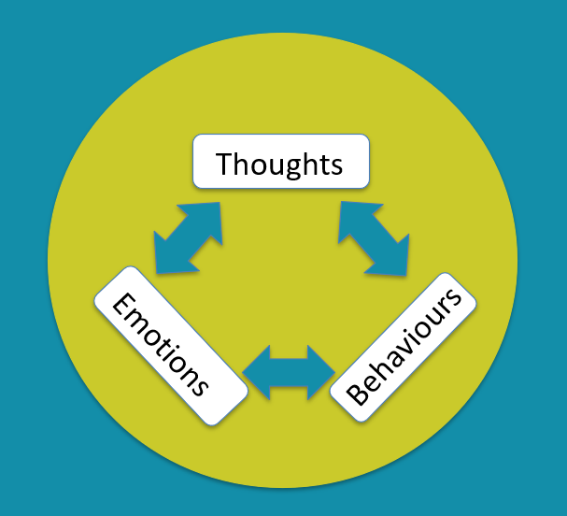
OUR MINDSET CAN CREATE UPWARD OR DOWNWARD SPIRALS
Notes:
Better to refer to upward and downward
Rather than positive and negative

Slide 12
Sam Whitelock and Kane Brisco
on ‘fixed’ versus ‘growth’ mindsets
Notes:
Play video
https://www.youtube.com/watch?v=dpcIjfE6RmY

Slide 13
FIXED VERSUS GROWTH MINDSET
Notes:
Carol Dweck PhD
Self check list – where are you? – Handout
Fill out and then talk to each other
What do you notice in yourself and others on farm on how this plays out in real life?

Slide 14
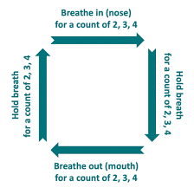
BOX BREATHING
Notes:
Demo it
Explain it
Get everyone to do it
When in high-stress situations, it's crucial to remain calm and think clearly. Navy SEALs use box breathing as a quick way to get the nervous system under control. The technique helps them stay focused and precise during critical operations.
Hold out your finger and pretend to draw the box, this helps focus your mind on drawing the box and not thinking about other things in your mind
Counting 1,2,3,4 helps you to focus more on the task
Breath from your diaphragm – Deep breathing
You can’t be stressed when breath deeply.
This exercise puts you into a focused and relaxed state.
Video to prepare with: https://youtu.be/n6RbW2LtdFs?si=BFaf6lNPLOqdIWCl

Slide 15
KEY TAKE HOMES
By being able to recognise the difference between a ‘fixed’ mindset’ and a ‘growth or flexible mindset’ will help you understand the impact it can have on you and others on farm.
Box Breathing is a simple exercise you can do when out on farm to refocus and relax
There are many tools out there for you to work with to manage your wellbeing
Farmstrong website is one of the platforms that hosts these tools so check it out
Rural support is there for one on one support so don’t be afraid to use them
Your the most important asset in your business!

Slide 16
Final word from Sam Whitelock

Slide 17
REACH OUT

